Slide 1

Does Learning Require Memorization?
A short tale about a long tail
_{Vitaly Feldman}
_{Research}
_{Brain team}

Slide 2
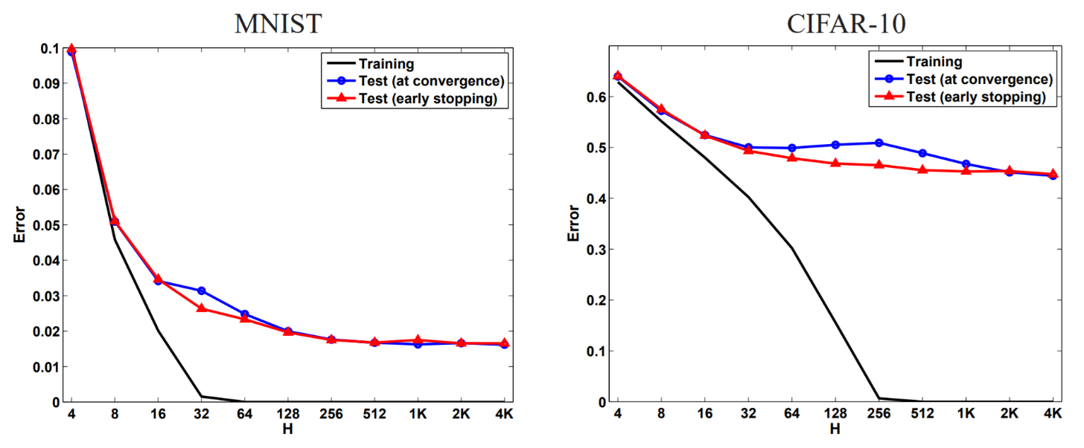
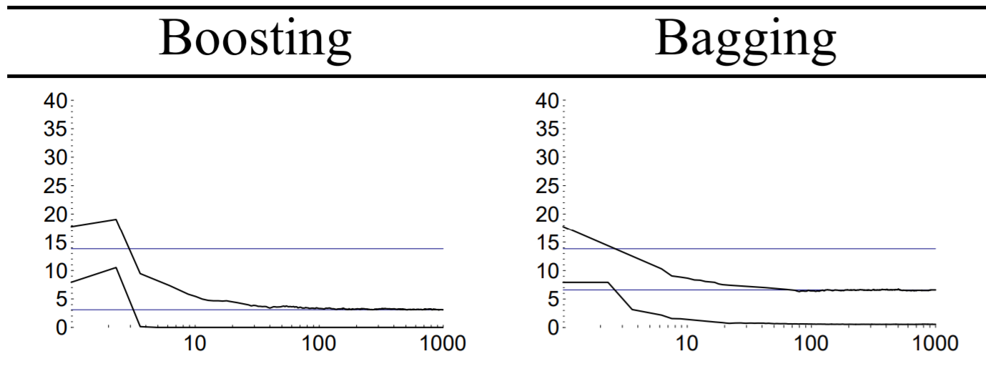
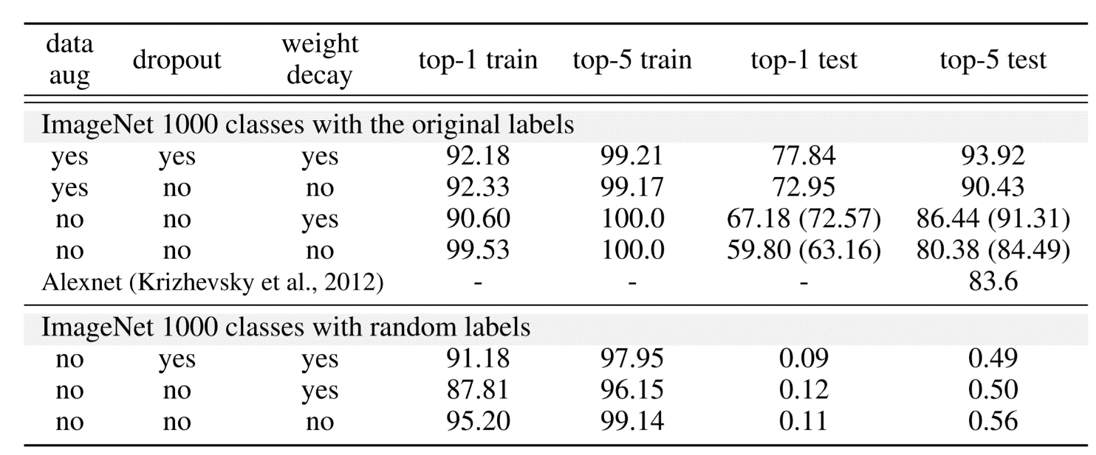
(Over?)fitting the dataset
UCI: letter recognition
[Schapire,Freund,Bartlett,Lee ‘98]
[Neyshabur,Tomioka,Srebro ‘15]
Inception v3 on Imagenet
[Zhang,Bengio,Hardt,Recht,Vinyals ‘17]

Slide 3
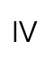

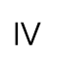

What about theory?
empirical
error
Controlled via a proxy
capacity, Rademacher compl., stability, information-based
Generalization error:
$err\left(\hat{h}\right)=\hat{err}\left(\hat{h}\right)+\left(err\left(\hat{h}\right)−\hat{err}\left(\hat{h}\right)\right)$
generalization gap
$$=$$
$$≥$$
$$≥$$
For randomly labelled example
or “outlier”:
$−v$ for $v∈\left[0,\frac{1}{n}\right]$ $+v$ $+\frac{1}{n}$ and often $Ω\left(\frac{1}{\sqrt{n}}\right)$
Why are modern ML algorithms tuned to memorize labels (if necessary)?

Slide 4
Related questions
Bounds on the generalization gap for DNNs
Norm/margin-based, stabiIity, description length, PAC-Bayes etc.
Increasing model size improves test error after fitting
Implicit regularization, better approximation
Generalization of interpolating methods
Interpolation may be “harmless”
Memorization also happens without interpolation
Does not address the “why?” question
Computational advantages of interpolation
SGD converges faster on some convex realizable problems
Little empirical support in the context of DNNs
[Schapire,Freund,Bartlett,Lee ’98;
Neyshabur,Tomioka,Srebro ’15;
Belkin,Ma,Mandal ’18 ….]
[Cover,Hart ’67; Belkin,Hsu,Mitra ‘18;
Liang,Rakhlin ’18; Belkin,Rakhlin,Tsybakov ’19;
Belkin,Hsu,Xu ’19; Bartlett,Long,Lugosi,Tsigler ‘19;
Hastie,Montanari,Rosset,Tibshirani ’19;
Muthukumar,Vodrahalli,Sahai ‘19….]
[Ma,Bassily,Belkin ’18]

Slide 5
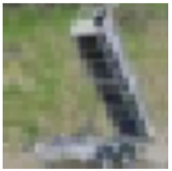
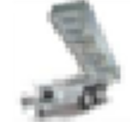

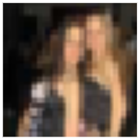

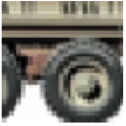
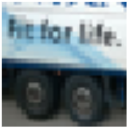
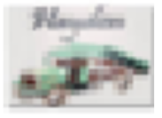
Hard rare examples
CIFAR-10 truck class
training set
test set
Can memorize only all or none!

Slide 6
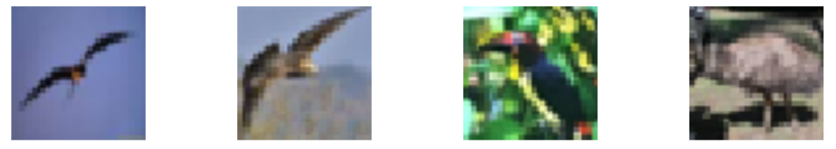
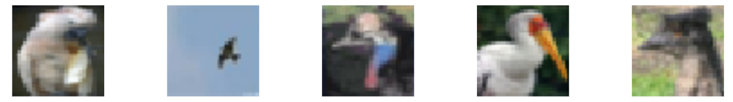
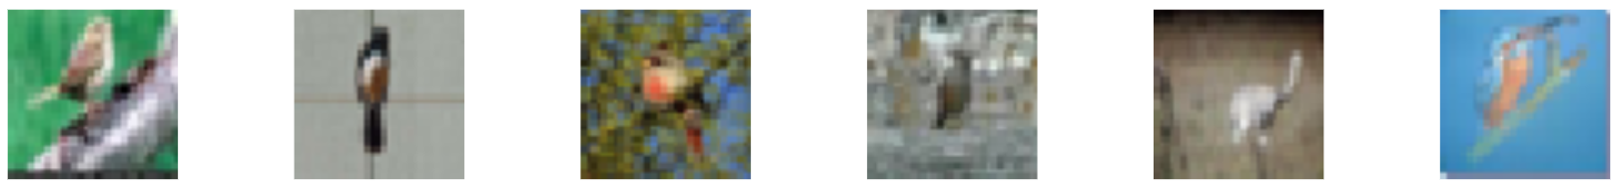
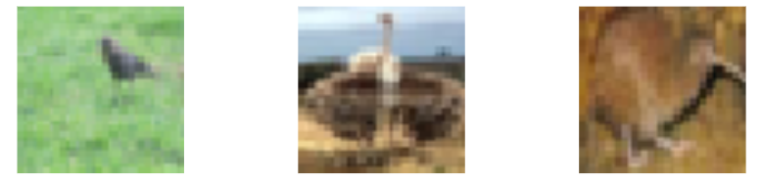
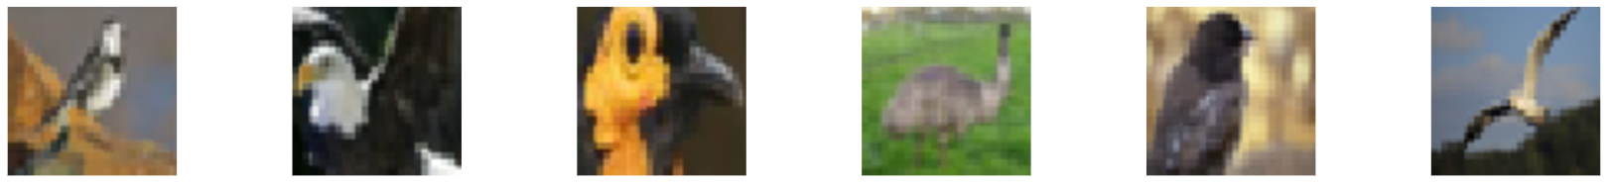
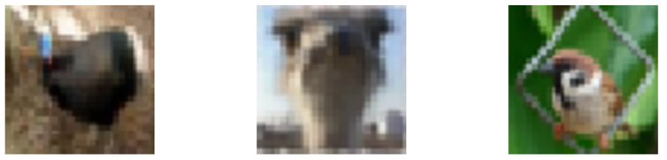
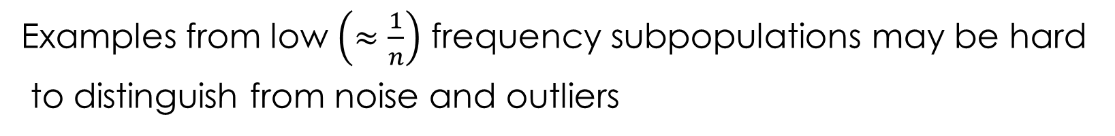
Subpopulations
CIFAR-10 birds
Examples from low $\left(≈\frac{1}{n}\right)$ frequency subpopulations may be hard
to distinguish from noise and outliers

Slide 7
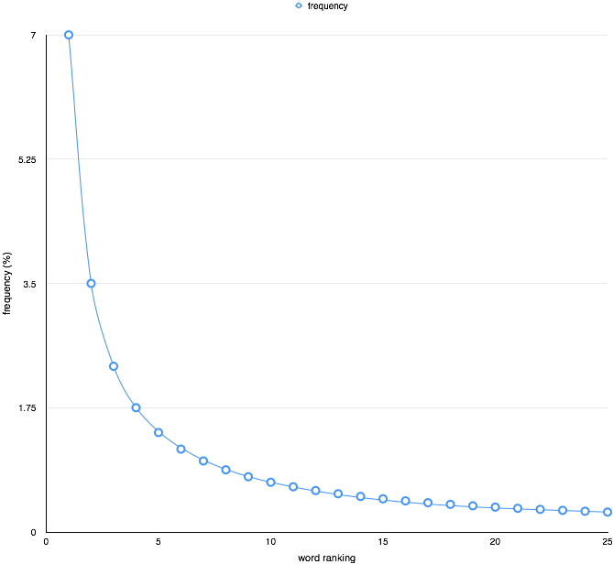
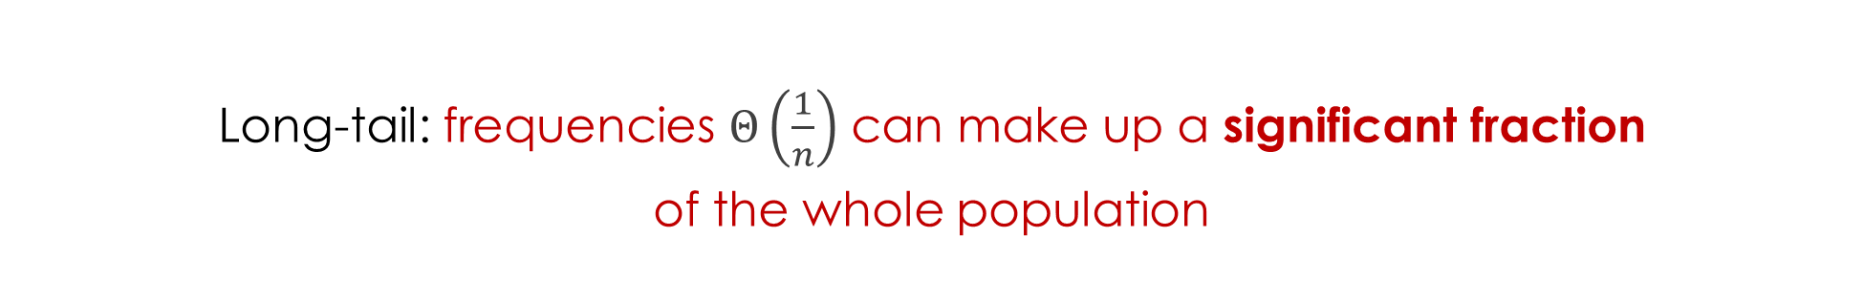
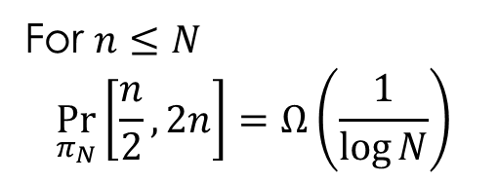
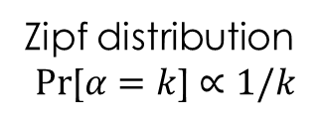
The tail rears its head
Long-tail: frequencies $Θ\left(\frac{1}{n}\right)$ can make up a significant fraction
of the whole population
For $n≤N$
$$\underset{π_{N}}{Pr}\left[\frac{n}{2},2n\right]=Ω\left(\frac{1}{\log{N}}\right)$$
Zipf distribution
$$Pr\text{[}α=k\text{]}∝1/k$$

Slide 8
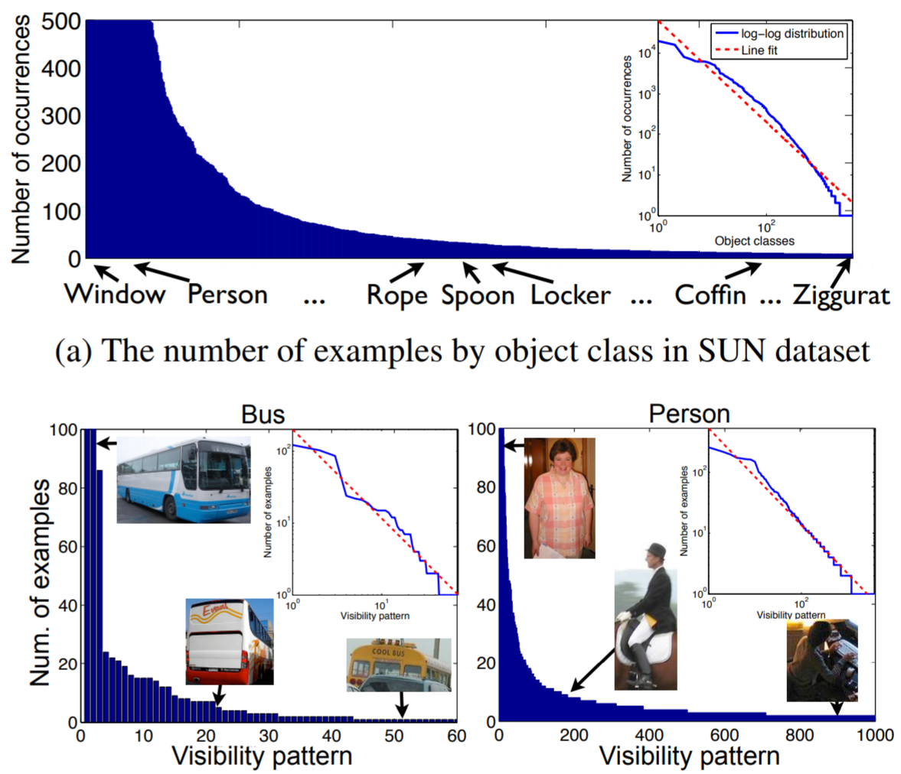
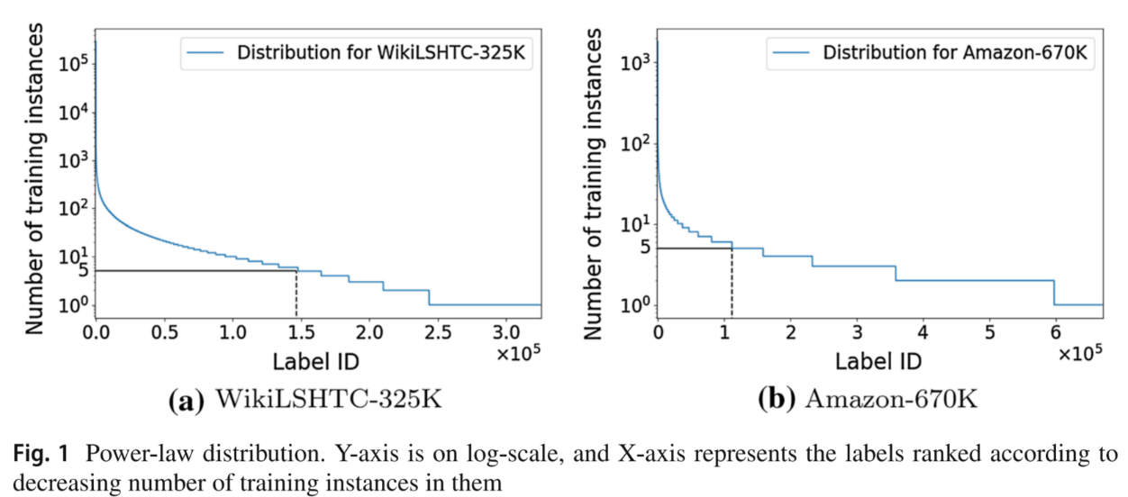
Long-tailed data
Additional annotations
Extreme multiclass problems
[Zhu, Anguelov, Ramanan ’14]
[Babbar,Scholkopf ‘19]

Slide 9
Privacy and memorization
Differentially private algorithms cannot memorize rare examples or fit perfectly
least accurate
most accurate
[Carlini,Erlingsson,Papernot ’18]
Do not achieve state-of-the-art accuracy: e.g. 98% on MNIST vs 99.8% non-privately

Slide 10
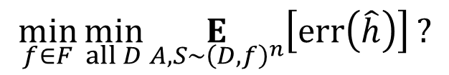
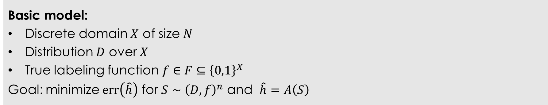
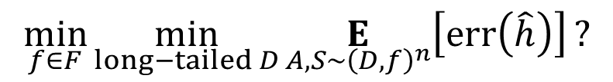
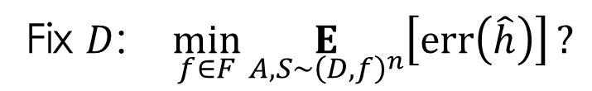
Model
Basic model:
Discrete domain $X$ of size $N$
Distribution $D$ over $X$
True labeling function $f∈F⊆{\left\{0,1\right\}}^{X}$
Goal: minimize $err\left(\hat{h}\right)$ for $S∼{\left(D,f\right)}^{n}$ and $\hat{h}=A\left(S\right)$
$$\min_{f∈F}{\min_{all D}{\underset{A, S∼{\left(D,f\right)}^{n}}{E}\left[err\left(\hat{h}\right)\right]}}?$$
Fix $D$: $\min_{f∈F}{\underset{A, S∼{\left(D,f\right)}^{n}}{E}\left[err\left(\hat{h}\right)\right]}?$
$$\min_{f∈F}{\min_{long−tailed D}{\underset{A, S∼{\left(D,f\right)}^{n}}{E}\left[err\left(\hat{h}\right)\right]}}?$$

Slide 11
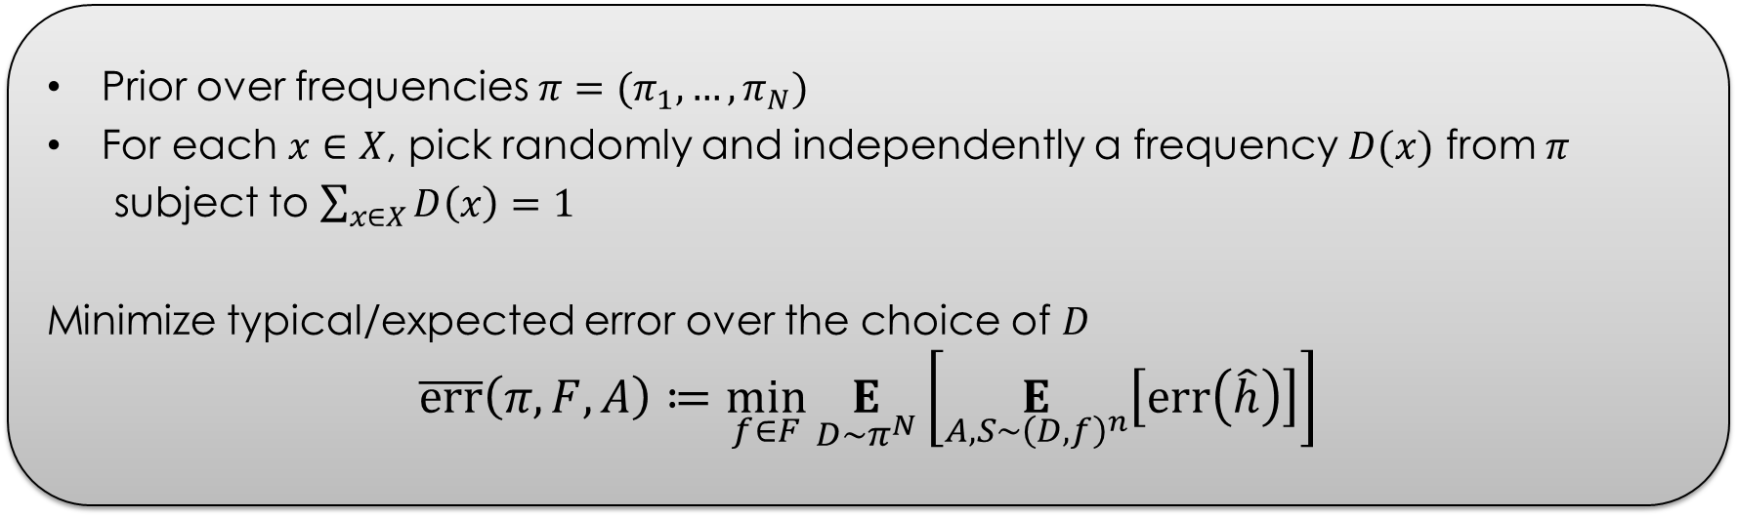
The typical error
Prior over frequencies $π=(π_{1},…,π_{N})$
For each $x∈X$, pick randomly and independently a frequency $D(x)$ from $π$
subject to $\sum_{x∈X}{D\left(x\right)=1}$
Minimize typical/expected error over the choice of $D$
$$\overline{err}\left(π,F,A\right)≔\min_{f∈F}\underset{D∼π^{N}}{E}\left[\underset{A, S∼{\left(D,f\right)}^{n}}{E}\left[err\left(\hat{h}\right)\right]\right]$$
Notes:
Can also minimize over family of priors over frequencies
Can turn it into a high-probability error

Slide 12
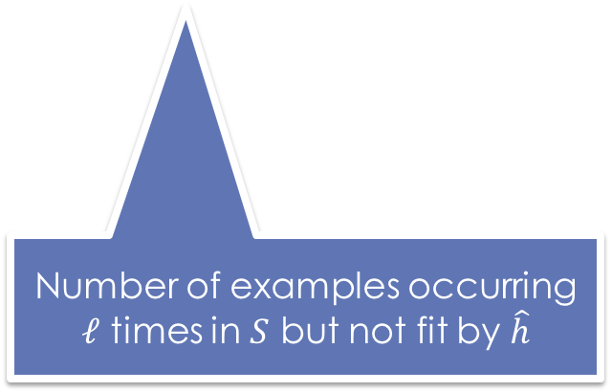
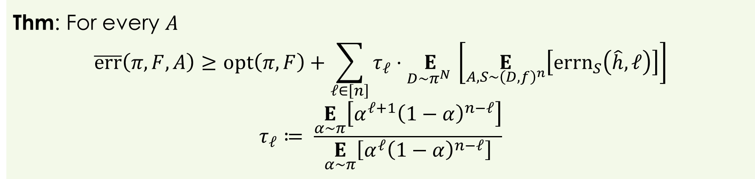
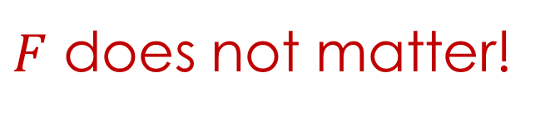
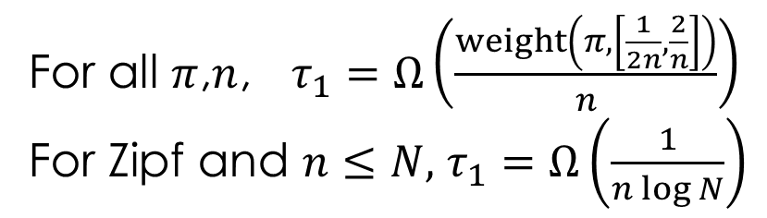
Benefits of fitting
Thm: For every $A$
$$\overline{err}\left(π,F,A\right)≥opt\left(π,F\right)+\sum_{ℓ∈\left[n\right]}{τ_{ℓ}⋅\underset{D∼π^{N} }{E}\left[\underset{A,S∼{\left(D,f\right)}^{n}}{E}\left[{errn}_{S}\left(\hat{h},ℓ\right)\right]\right]}$$
$$τ_{ℓ}≔ \frac{\underset{α∼π}{E}\left[α^{ℓ+1}{\left(1−α\right)}^{n−ℓ}\right]}{\underset{α∼π}{E}\left[α^{ℓ}{\left(1−α\right)}^{n−ℓ}\right]}$$
Number of examples occurring $ℓ$ times in $S$ but not fit by $\hat{h}$
For all $π$,$n$, $τ_{1}=Ω\left(\frac{weight\left(π,\left[\frac{1}{2n},\frac{2}{n}\right]\right)}{n}\right)$
For Zipf and $n≤N,$ $τ_{1}=Ω\left(\frac{1}{n\log{N}}\right)$
$F$ does not matter!

Slide 13
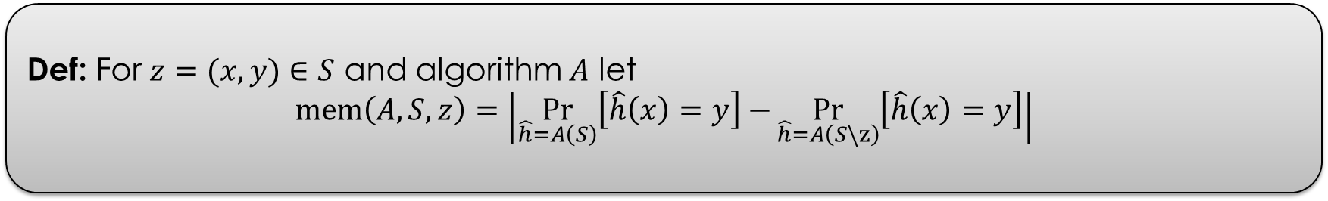
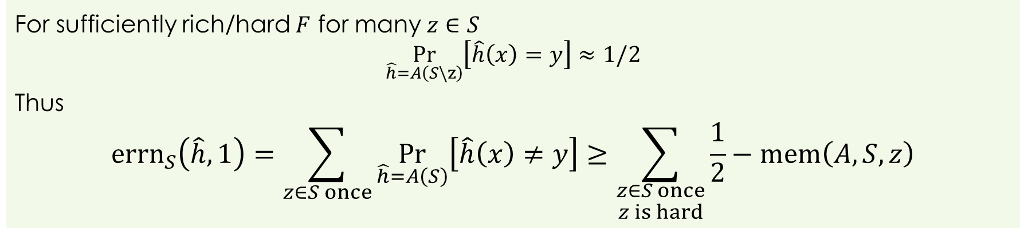
Fitting and memorization
Def: For $z=(x,y)∈S$ and algorithm $A$ let
$$mem\left(A,S,z\right)=\left|\underset{\hat{h}=A\left(S\right)}{Pr}\left[\hat{h}\left(x\right)=y\right]−\underset{\hat{h}=A\left(S\backslash z\right)}{Pr}\left[\hat{h}\left(x\right)=y\right]\right|$$
For sufficiently rich/hard $F$ for many $z∈S$
$$\underset{\hat{h}=A\left(S\backslash z\right)}{Pr}\left[\hat{h}\left(x\right)=y\right]≈1/2$$
Thus
$${errn}_{S}\left(\hat{h},1\right)=\sum_{z∈S once}{\underset{\hat{h}=A\left(S\right)}{Pr}\left[\hat{h}\left(x\right)≠y\right]}≥\sum_{\begin{aligned}z∈S once \\ z is hard\end{aligned}}{\frac{1}{2}−mem\left(A,S,z\right)}$$

Slide 14
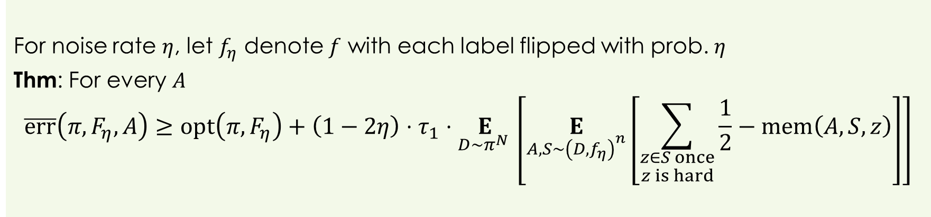
Label noise
For noise rate $η$, let $f_{η}$ denote $f$ with each label flipped with prob. $η$
Thm: For every $A$
$$\overline{err}\left(π,F_{η},A\right)≥opt\left(π,F_{η}\right)+\left(1−2η\right)⋅τ_{1}⋅\underset{D∼π^{N} }{E}\left[\underset{A,S∼{\left(D,f_{η}\right)}^{n}}{E}\left[\sum_{\begin{aligned}z∈S once \\ z is hard\end{aligned}}{\frac{1}{2}−mem\left(A,S,z\right)}\right]\right]$$
Optimal algorithm no longer interpolates $S$

Slide 15
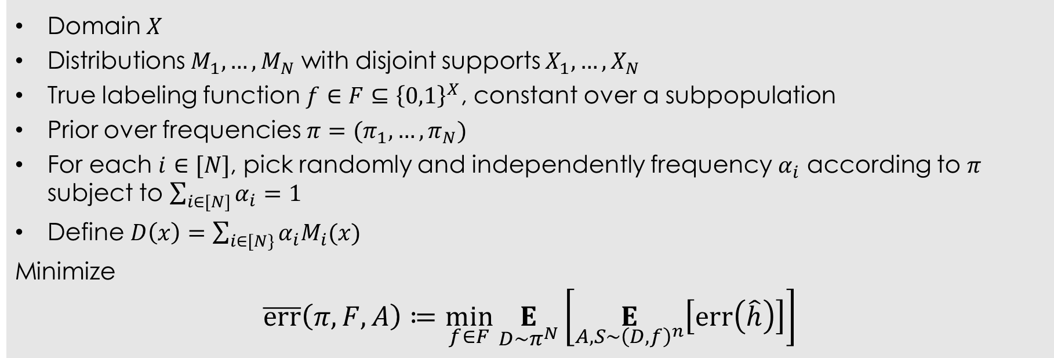
Beyond discrete domains
Domain $X$
Distributions $M_{1},…,M_{N}$ with disjoint supports $X_{1},…,X_{N}$
True labeling function $f∈F⊆{\left\{0,1\right\}}^{X}$, constant over a subpopulation
Prior over frequencies $π=(π_{1},…,π_{N})$
For each $i∈[N]$, pick randomly and independently frequency $α_{i}$ according to $π$ subject to $\sum_{i∈[N]}{α_{i}=1}$
Define $D\left(x\right)=\sum_{i∈[N\}}{α_{i}M_{i}(x)}$
Minimize
$$\overline{err}\left(π,F,A\right)≔\min_{f∈F}\underset{D∼π^{N}}{E}\left[\underset{A,S∼{\left(D,f\right)}^{n}}{E}\left[err\left(\hat{h}\right)\right]\right]$$

Slide 16
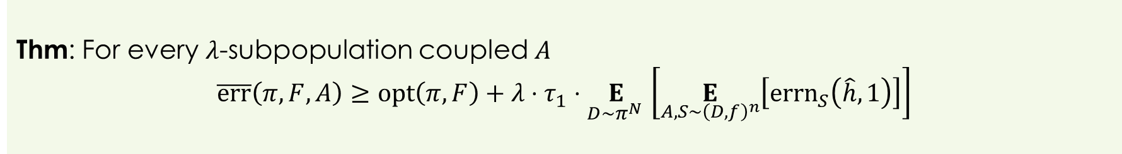
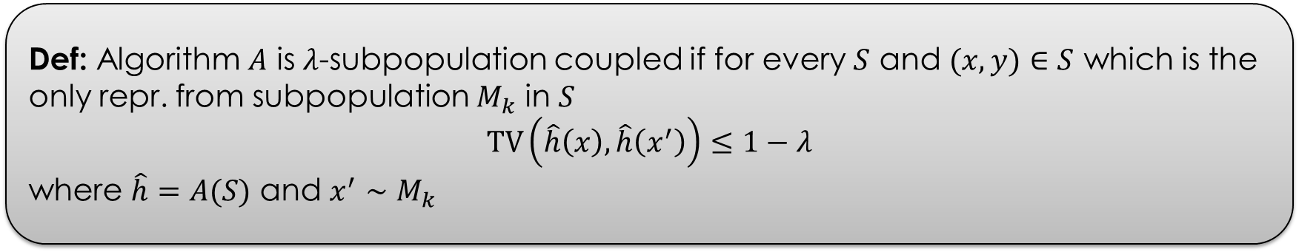
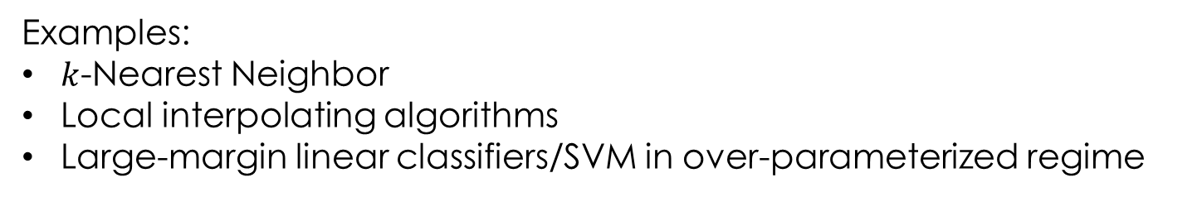
Coupling
Def: Algorithm $A$ is $λ$-subpopulation coupled if for every $S$ and $(x,y)∈S$ which is the only repr. from subpopulation $M_{k}$ in $S$
$$TV\left(\hat{h}\left(x\right),\hat{h}\left(x^{′}\right)\right)≤1−λ$$
where $\hat{h}=A(S)$ and $x^{′}∼M_{k}$
Thm: For every $λ$-subpopulation coupled $A$
$$\overline{err}\left(π,F,A\right)≥opt\left(π,F\right)+λ⋅τ_{1}⋅\underset{D∼π^{N} }{E}\left[\underset{A,S∼{\left(D,f\right)}^{n}}{E}\left[{errn}_{S}\left(\hat{h},1\right)\right]\right]$$
Examples:
$k$-Nearest Neighbor
Local interpolating algorithms
Large-margin linear classifiers/SVM in over-parameterized regime

Slide 17

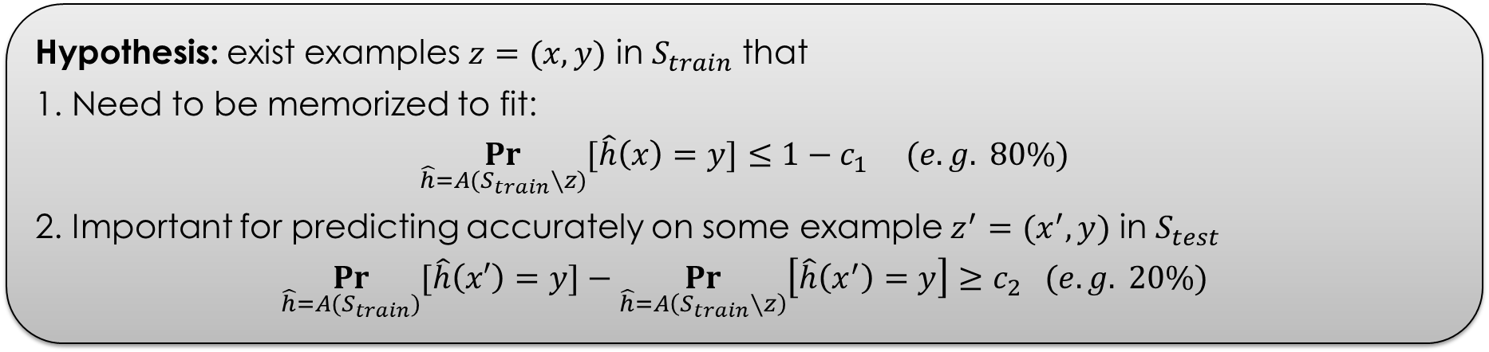
Experiments (with Chiyuan Zhang)
Hypothesis: exist examples $z=(x,y)$ in $S_{train}$ that
1. Need to be memorized to fit:
$$\underset{\hat{h}=A(S_{train}∖z)}{Pr}{[\hat{h}\left(x\right)=y]}≤{1−c}_{1} (e.g. 80\%)$$
2. Important for predicting accurately on some example $z^{′}=(x^{′},y)$ in $S_{test}$
$$\underset{\hat{h}=A(S_{train})}{Pr}{[\hat{h}\left(x′\right)=y]}−\underset{\hat{h}=A\left(S_{train}∖z\right)}{Pr}\left[\hat{h}\left(x^{′}\right)=y\right]≥c_{2} (e.g. 20\%)$$
Fraction of such examples is significant
Significant cumulative effect on test error
EXAMPLES
FROM THE
LONG TAIL
Computationally prohibitive to find directly
(even on MNIST)

Slide 18
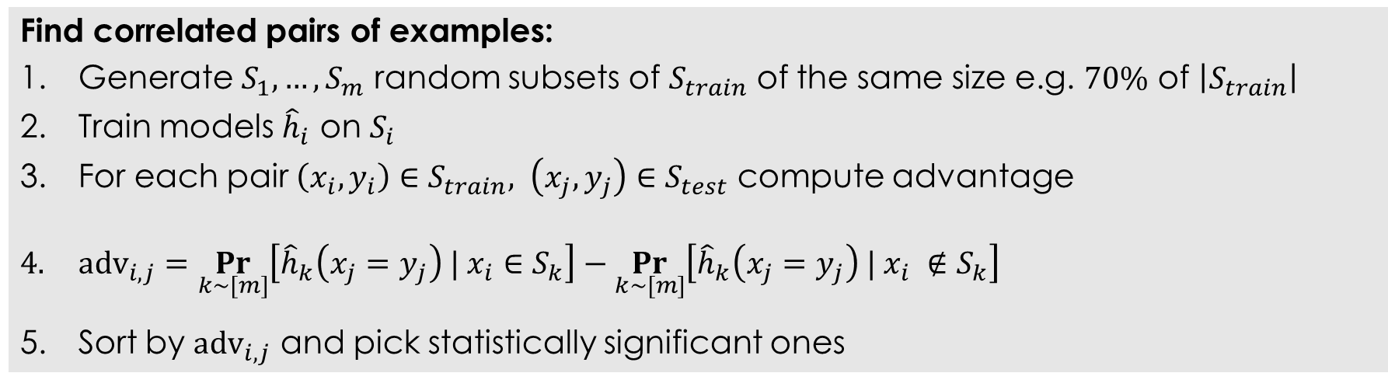
Method
Find correlated pairs of examples:
Generate $S_{1},…,S_{m}$ random subsets of $S_{train}$ of the same size e.g. $70\%$ of $\left|S_{train}\right|$
Train models ${\hat{h}}_{i}$ on $S_{i}$
For each pair $\left(x_{i},y_{i}\right)∈S_{train}, \left(x_{j},y_{j}\right)∈S_{test}$ compute advantage
$adv_{i,j}=\underset{k∼[m]}{Pr}\left[{\hat{h}}_{k}\left(x_{j}=y_{j}\right) | x_{i}∈S_{k}\right]−\underset{k∼[m]}{Pr}\left[{\hat{h}}_{k}\left(x_{j}=y_{j}\right) | x_{i} ∉S_{k}\right]$
Sort by $adv_{i,j}$ and pick statistically significant ones
Still computationally intensive: requires large $m$ (>1,000)

Slide 19
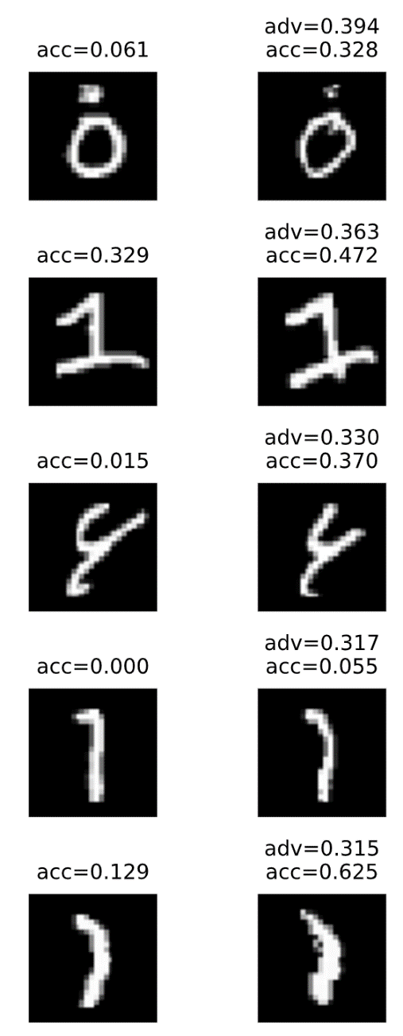
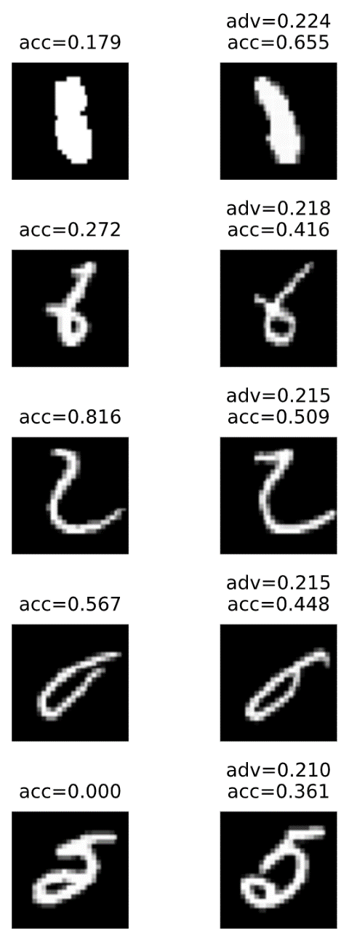
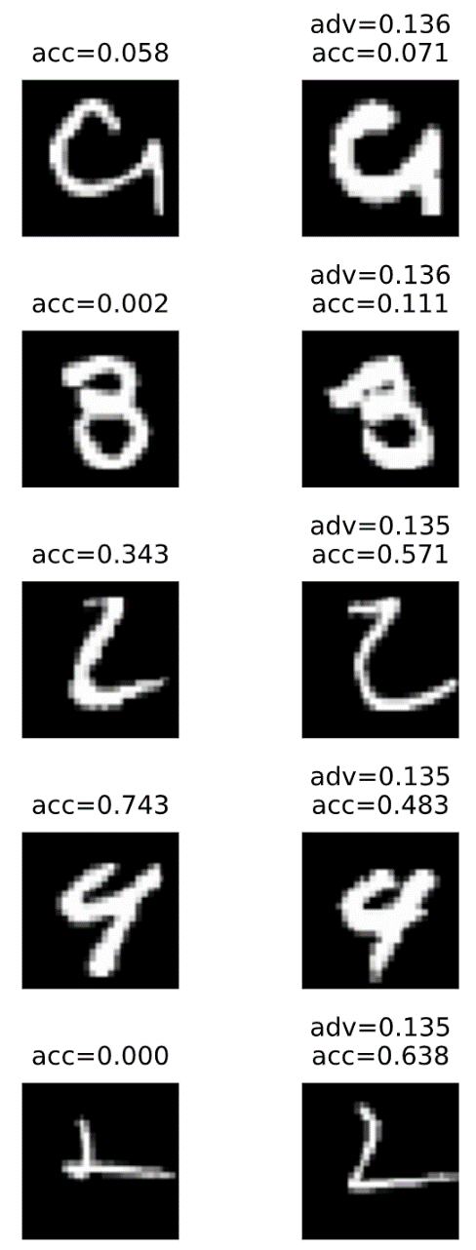
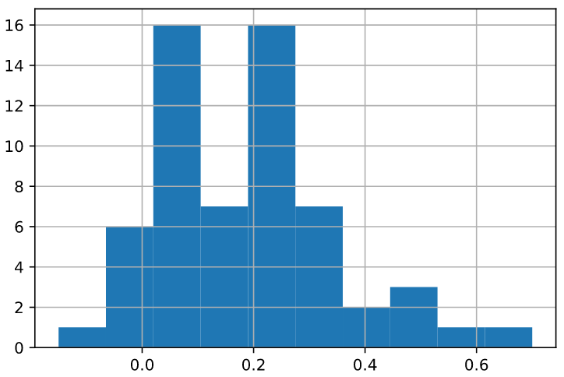
Results (MNIST)
train
test
train
test
train
test
MNIST:
50,000 train; 10,000 test
10 classes
Algo: SGD on simple CNN
99+% accuracy
70+ examples with
>10% advantage

Slide 20
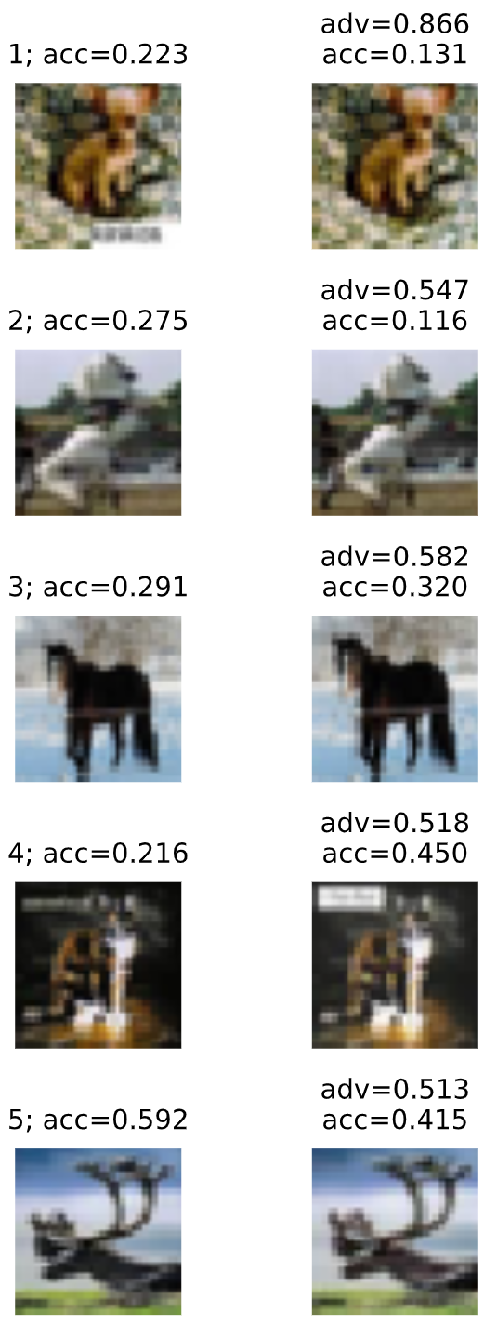
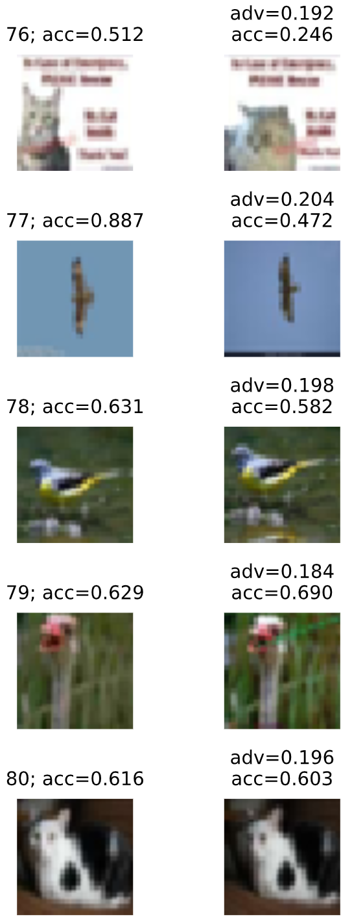
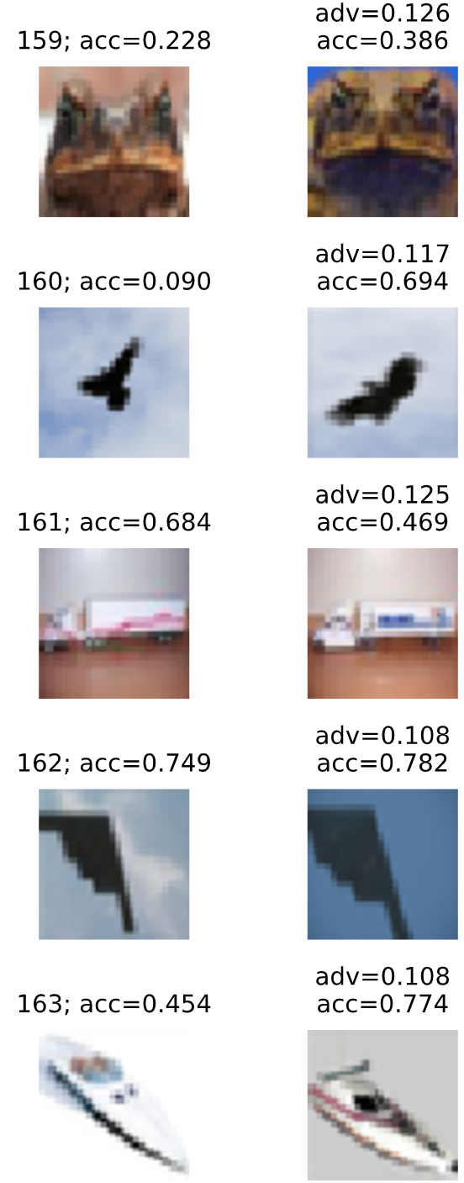
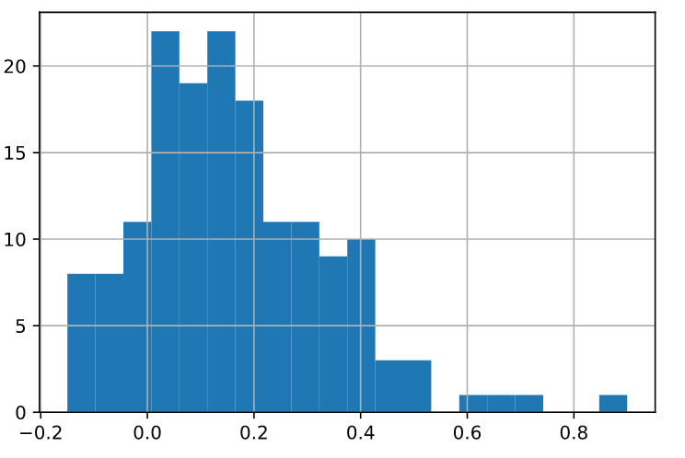
Results (CIFAR-10)
train
test
train
test
train
test
CIFAR-10:
50,000 train; 10,000 test
10 classes
Algo: SGD on Inception
87% accuracy
170+ examples with
>10% advantage

Slide 21



Results (CIFAR-100)
train
test
train
test
train
test
CIFAR-100:
50,000 train; 10,000 test
100 classes
Algo: SGD on Inception
62+% accuracy
700+ examples with
>10% advantage

Slide 22
Conclusions
Label memorization is not explained by prior work
Different from interpolation
Memorization maybe beneficial even in the presence of noise/outliers
New theory: typical error and long-tailed subpopulation frequencies
Overfitting is necessary for optimal generalization
Future work
More faithful theoretical models
Insights for better learning algorithms
Implications for privacy and fairness

